Slide 1




Building Rich Domain Models with DDD and TDD
Ivan Paulovich
Betsson Dev'talk #3
Stockholm – September 12th, 2018
https://paulovich.net
ivan.paulovich@betssongroup.com
@ivanpaulovich
Notes:
Thank you for joining the Betsson Meetup.
I am going to talk about Domain-Driven Design and Test-Driven Development.

Slide 2


Ivan Paulovich
Developer
Photo by Rafaela Biazi on Unsplash
30+ Microsoft Certifications
paulovich.net
Notes:
First let me introduce myself, I am Ivan Paulovich and I moved to Stockholm earlier this year to be a Developer for Betsson. I used to be na MVP in asp.net for a few years and now I am in the MVP Reconnect Program.
My background is Development, Architecture and Cloud and I earned few Microsoft Certifications.
I support the Paulovich.net blog and I am active in GitHub.

Slide 3
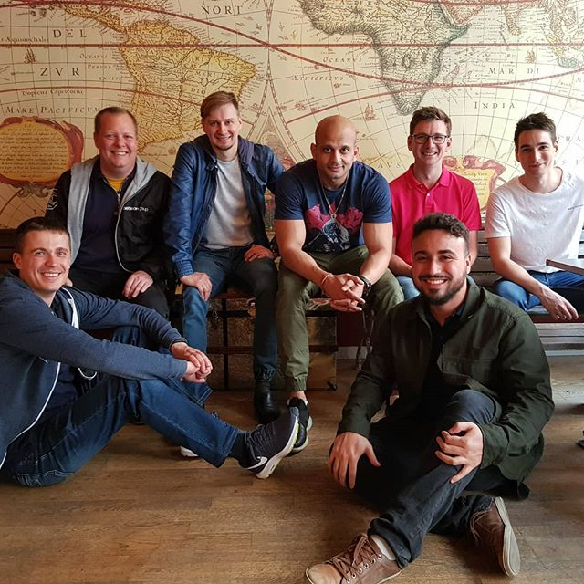
Betsson Wallet Team
Seniors Developers
Agile Team
Business Oriented
.NET – SQL Server – Angular
Stockholm Office
We are hiring!
Notes:
I work with those guys, we are team of seniors developers following agile practices and we deliver the features the business wants.
Our tech stack is .NET, SQL Server and Angular.
If you are open to discuss opportunities we are hiring! Try to talk with HR and those developers.

Slide 4
How to shoot yourself in the foot:
Design your application starting from the data model.
Create your domain model by reverse engineering.
Pretend that you’re doing TDD and start testing your domain classes.
Particularly getters and setters.
Now start testing the logic with Integration Tests and get stuck by test data and related issues.
Declare that TDD provides no benefit and only slows you down.
Comment tests in your Continuous Integration proccess.
Keep on whining.
Alberto Brandolini
Notes:
Let’s begin with a sad and common story that I copied from Alberto Brandolini. Its about designing the software from the data model using reverse engineering to make the Domain Model fit wihtin the Data Model.
And by pretending doing TDD testing getters and setters. Doing integration tests and get stuck by test data and related issues.
Disappointing about TDD benefits and removing tests from the CI.

Slide 5
Domain-Driven Design
Test-Driven Development
Tiny Domain Objects
Exploratory Programming
Focus on Unit Tests
Frequent Short Cycles
Frequent Rewriting
Quick Feedback
Self Explanatory Coding
Confidence to Change
Notes:
Fortunately we move to a more happier story about Domain-Driven Design and Test-Driven Developmen.t
Alone this topics are huge and I will explain how they can be used together.
On one side DDD provides this Tiny Domain Objects, Exploratory Programming.. On the other side TDD with Unit Tests, short cycles and confidence to change.
Both target a Self Explanatory Coding, Quick feedback and Rewriting.
My strategy is to talk is to introduce DDD and bit by bit talk about TDD.

Slide 6
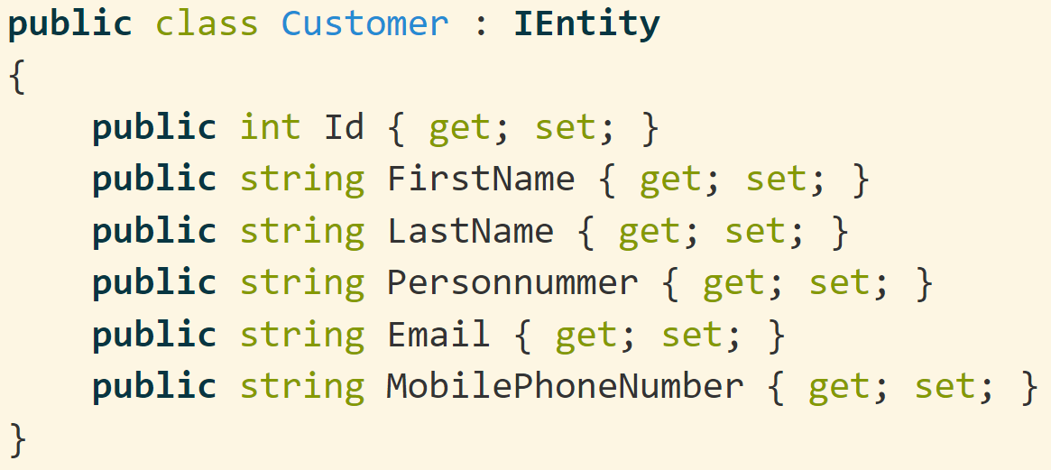
A Customer Entity with Primitive Obsession...
Notes:
Let’s explicit the problem:
This is a Customer Entity, all the properties are strings. It does have rich methods and all data are exposed as public.

Slide 7
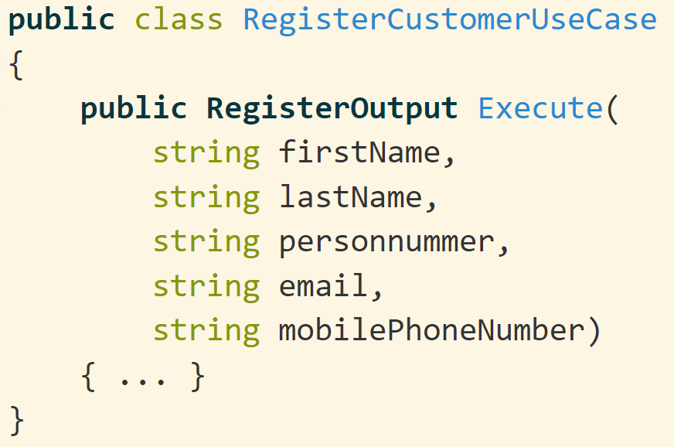
Leads to Services Like..
Needs to verify for required parameters, Data Format and Data Range.
Services are Big and Fat.
Easy to confuse one parameter with the another.
Notes:
The previous class leads to Services like this, if wanna register a Customer the service receive string parameters that we need to verify for data range, format and what is mandatory or not.
Usually it became unecessary big and fat also it is easy to confuse one parameter with another.

Slide 8
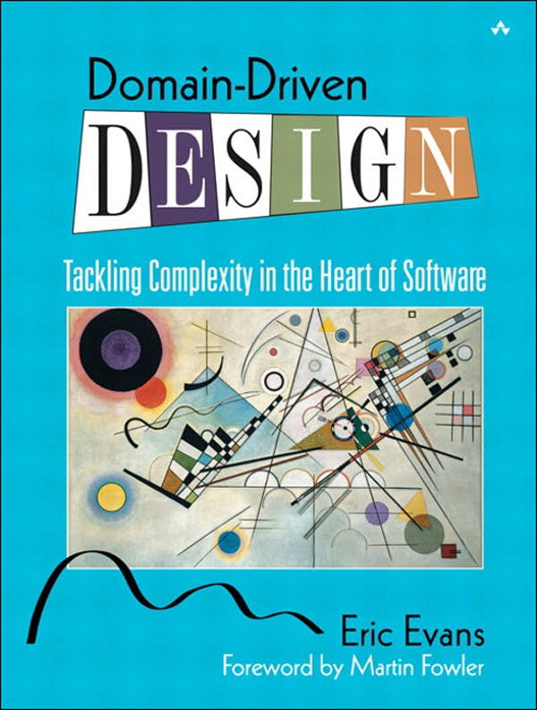
Not a technology.
Not a methodology.
Set of principles and patterns for focusing the design effort where it matters most.
Notes:
Then we are enlightened with DDD. Which is not a technology, not a methodology. It is a set os principles and patterns for focus the design effort where it matters.

Slide 9
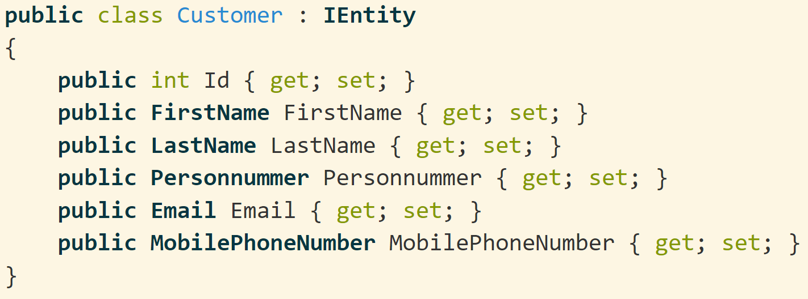
A Customer Entity Using Value Objects..
Notes:
I could replace the string properties with specialized classes that we call Value Objects, this tiny classes enforces the smallest business rules.

Slide 10
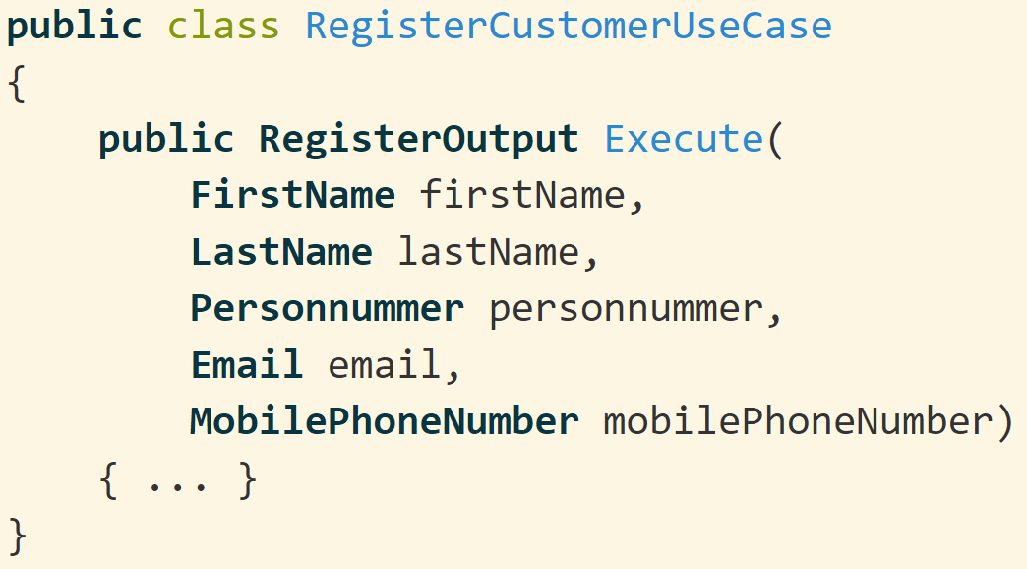
Business Rules Enforced Through Value Objects
The simple existence of a Value Object means that it is valid.
No need to verify parameters values on every method.
Services are thinner and smaller when using Value Objets.
Notes:
And it leads to thinner Services, that do not require to validate the arguments of every method. The simple existence of a Value Object means that it is valid.
A quick tip about services is that they do not have state.

Slide 11
DDD express the Model with Value Objects, Entities and Services.
Some Entities act as root of Aggregates.
Notes:
DDD express the Model with Value Objects, Entities and Services.. Some Entities are Aggregate Roots. At this moment it is not clear.

Slide 12
An Example with Some Use Cases
A customer can register a new account using its personal details.
Allow a customer to deposit funds into an existing account.
Allow to withdraw from an existing account.
Do not allow to withdraw more than the current balance.
Notes:
So.. I will explain using Use Cases.
A Customer can register a new account then deposit and withdraw funds. The customer can not withdraw more that the current balance.

Slide 13
Customer 5557-8
Account Number 4444-6 (Day-to-Day)
Date | Description | Debit (SEK) | Credit (SEK) | Balance (SEK)
01-08-2018 | Initial Balance |  |  | 50,000
03-08-2018 | Withdrawn | 10,000 |  | 40,000
07-08-2018 | Withdrawn | 5,000 |  | 35,000
17-09-2018 | Deposited |  | 7,000 | 42,000
Account Number 7777-0 (Savings)
Date | Description | Debit (SEK) | Credit (SEK) | Balance (SEK)
01-09-2018 | Initial Balance |  |  | 10,000
Notes:
This table make the use cases clear.
A customer can have multiple accounts, each account has a transaction history and we can get the balance any time.

Slide 14
Some Noums and Verbs are Useful
A customer can register a new account using its personal details.
Allow a customer to deposit funds into an existing account.
Allow to withdraw from an existing account.
Do not allow to withdraw more than the current balance.
Notes:
The previous use cases are useful to identify some noums and verbs. It helps do draw the initial Design.

Slide 15
Tactical-Design
First Name
Customer
Last Name
Account
Opening Date
Personnummer
Mobile Phone Number
Amount
Debit
Amount
Credit
Transaction Date
Transaction Date
Amount
Description
Description
Notes:
This figure is another representation the Domain.
In blue the Entities and in green the Value Objects that describe the entities.

Slide 16
Tactical-Design
First Name
Customer
Last Name
Account
Opening Date
Personnummer
Mobile Phone Number
Amount
Debit
Amount
Credit
Transaction Date
Transaction Date
Amount
Description
Description
Notes:
The Customer and Account perform the Aggregate Root role, I am going to explain soon.

Slide 17
Tactical-Design
First Name
Customer
Personal Expenses Bounded Context
Last Name
Account
Opening Date
Personnummer
Mobile Phone Number
Amount
Debit
Amount
Credit
Transaction Date
Transaction Date
Amount
Description
Description
Notes:
And of course, this structures are only valid inside the Personal Expenses Bounded Context.

Slide 18
Technical Aspects of Design
Technical Terms
Technical Design Patterns
Business Terms Developers Don’t Understand
Business Terms Everyone Uses That Don’t Appear in Design
Domain Model Terms
Names of Bounded Contexts
Terminology of Large-scale Structures
DDD Patterns Names
Developers
Domain Experts
Ubiquitous Language
Notes:
The fundamentals of DDD is to build an Ubiquitous Language, this is the vocabulary that is shared between Developers and Domain Experts.
Developers have jargons, they know technical stuff. And Domain Experts focus in the Business.
There are some terms that both should know to create a shared language.
The Domain Model Terms, Bounded Contexts, DDD pattterns names and high level structures.
Everything else are not ubiquitous.

Slide 19
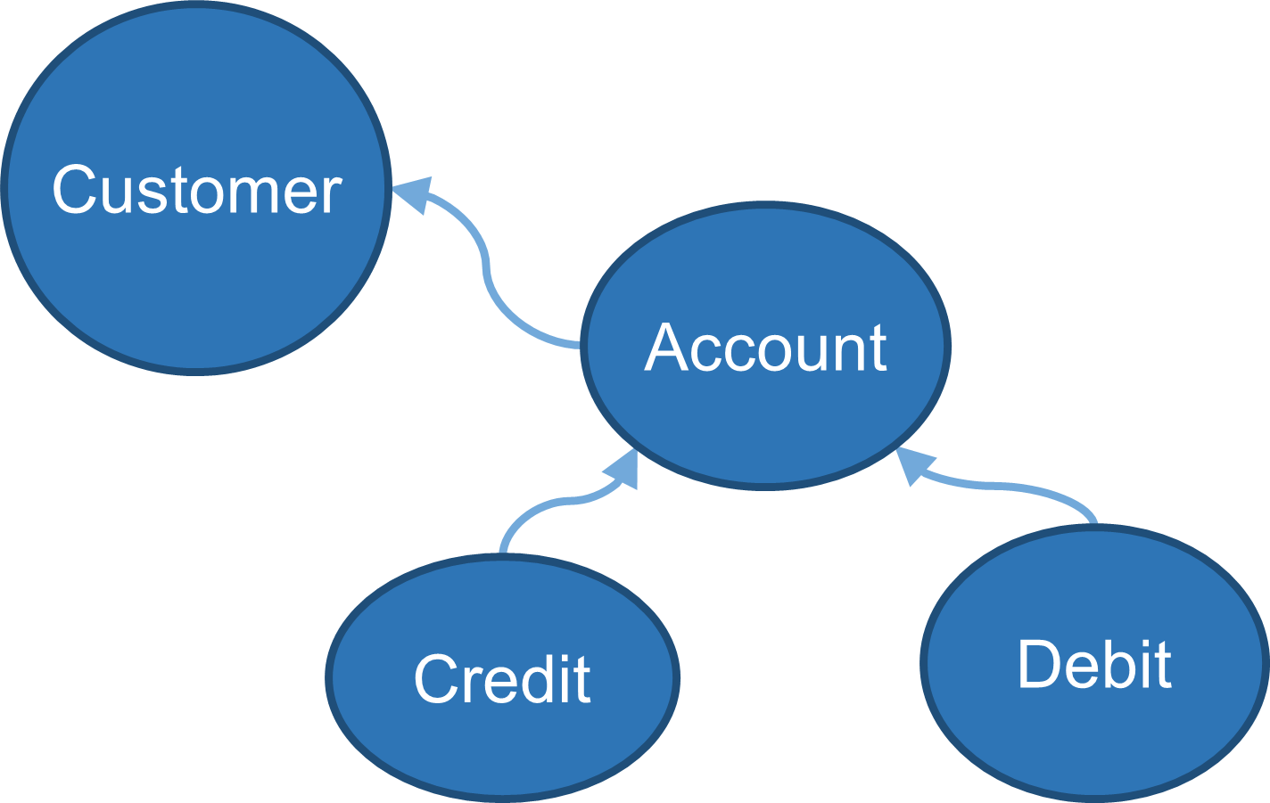
Entities
Have a unique identity.
Are mutable or not.
Refer others entities by their IDs.
Notes:
The entity pattern requires that every entity has an unique id. The entity could be mutable or not, and they refer other entities by ID. In our example the Customer, Account, Credit and Debit are Entities.

Slide 20
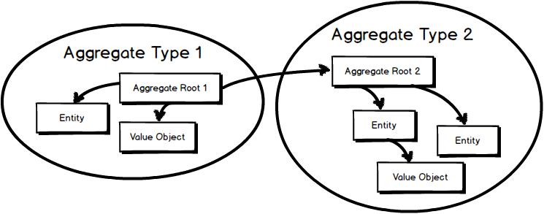
Aggregate Roots (Are Entities)
Refer other aggregates by identity only.
Scope of consistency inside the aggregate boundaries.
Eventual consistency between aggregates.
Aggregates are small.
Aggregates implement behaviors.
Entity + Repository ~ Aggregate
One Aggregate Root for every Entity is a Code Smell.
Notes:
An Aggregate Root is a specialized Entity that control the scope of consistency inside the aggregate boundaries. Usually the aggregate root is a bunch of entities that are seen as one single unit.
The aggregates are small, they implement behaviors with methods.
And I advance that one entity plus one repository pattern are close to an Aggregate.

Slide 21

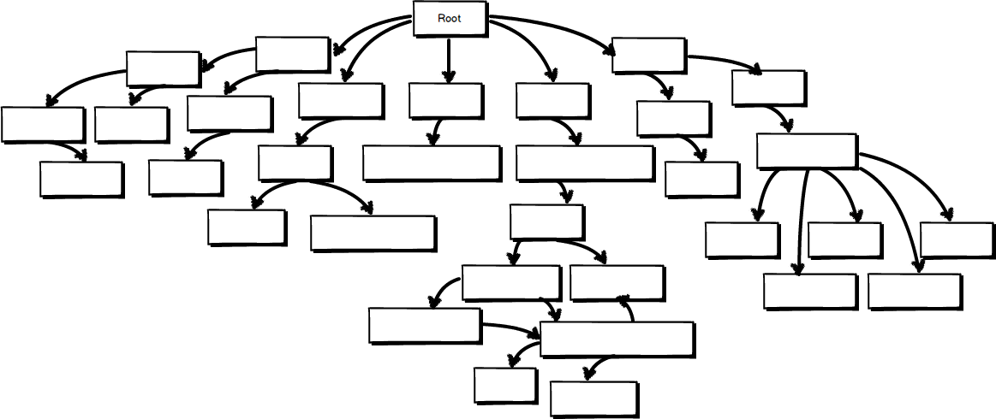
An Aggregate Root is not your Entire Model
Notes:
Another way to explain the Aggregate Pattern, is by what it is not.
The aggregate is not your Entire Model, the same way as this bunch of grapes that we can not identify the boundaries.

Slide 22

An Aggregate Root
Notes:
Aggregate Roots are small as this bunch of grapes that we can see the boundaries. It is possible to maitain the consistency of the business rules.

Slide 23
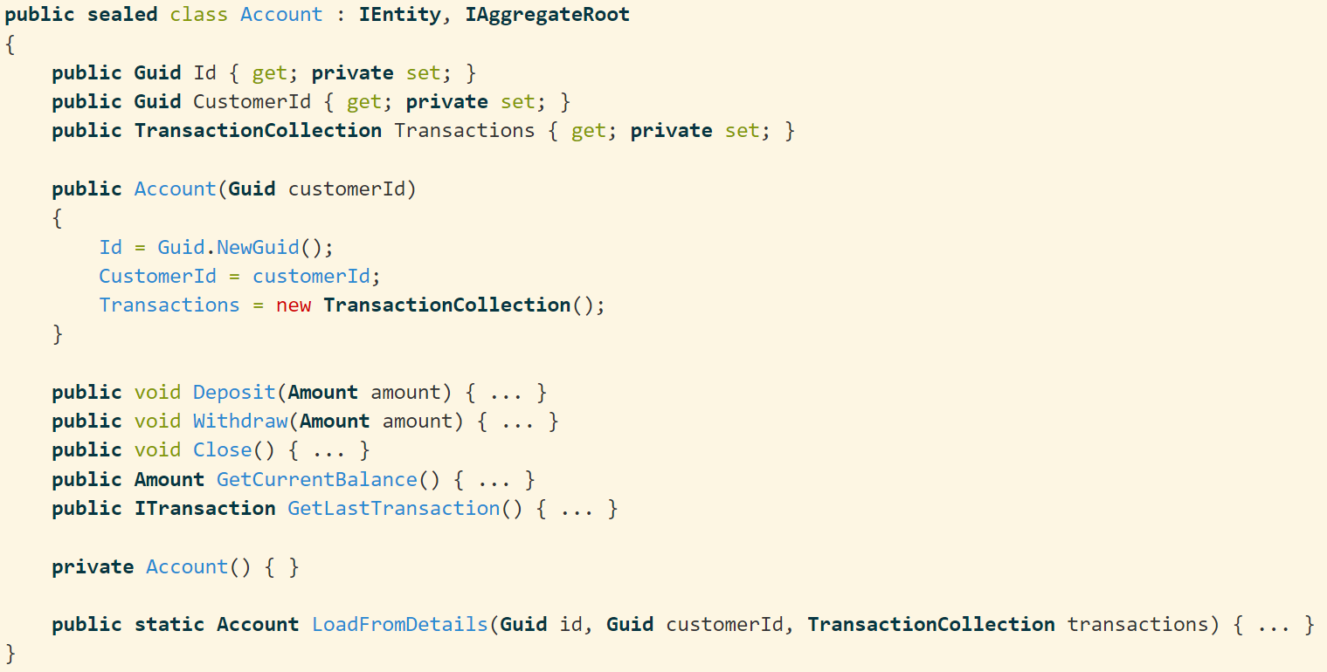
Account Aggregate Root

Slide 24
Account Aggregate Root
It is an Entity

Slide 25
Account Aggregate Root
It is an Entity
Only mandatory fields are required in the constructor

Slide 26
Account Aggregate Root
It is an Entity
Only mandatory fields are required in the constructor
Implements behaviors which maintain the state consistent.

Slide 27
Account Aggregate Root
It is an Entity
Only mandatory fields are required in the constructor
Implements behaviors which maintain the state consistent.
Factory method to restore state.

Slide 28
Value Objects
Immutable.
Have no explicit identity.
Unique by the comparison of the attributes.
Used to describe, measure or quantify an Entity.
First Name
Last Name
Personnummer
Amount
Description
Mobile Phone Number

Slide 29
.NET Bounded Context
Personal Expenses Bounded Context
Mobile Phone Number
string

Slide 30
.NET Bounded Context
Personal Expenses Bounded Context
Clone
Compare
CompareOrdinal
CompareTo
Concat
Contains
Copy
CopyTo
Create
EndsWith
Equals
Format
GetEnumerator
GetHashCode
GetTypeCode
IndexOf
IndexOfAny
Insert
Intern
IsInterned
IsNormalized
IsNullOrEmpty
IsNullOrWhiteSpace
Join
LastIndexOf
LastIndexOfAny
Normalize
PadLeft
PadRight
Remove
Replace
Split
StartsWith
Substring
ToCharArray
ToLower
ToLowerInvariant
ToString
ToUpper
ToUpperInvariant
Trim
TrimEnd
TrimStart
Mobile Phone Number
string

Slide 31
.NET Bounded Context
Personal Expenses Bounded Context
Clone
Compare
CompareOrdinal
CompareTo
Concat
Contains
Copy
CopyTo
Create
EndsWith
Equals
Format
GetEnumerator
GetHashCode
GetTypeCode
IndexOf
IndexOfAny
Insert
Intern
IsInterned
IsNormalized
IsNullOrEmpty
IsNullOrWhiteSpace
Join
LastIndexOf
LastIndexOfAny
Normalize
PadLeft
PadRight
Remove
Replace
Split
StartsWith
Substring
ToCharArray
ToLower
ToLowerInvariant
ToString
ToUpper
ToUpperInvariant
Trim
TrimEnd
TrimStart
Mobile Phone Number
string
Create
GetAreaCode
GetLastFourDigits
ToString

Slide 32
We only pay for the complexity we really use
Without Value Objects
With Value Objects
We bring the .NET Framework Complexity into our Bounded Context.
Personal Expenses Bounded Context
Personal Expenses Bounded Context
Phone Number
null
Thread
string int
collection
.NET Bounded Context
double
string
int
null
Thread
collection
HttpClient
.NET Bounded Context
Reflection
double
HttpClient
Reflection

Slide 33
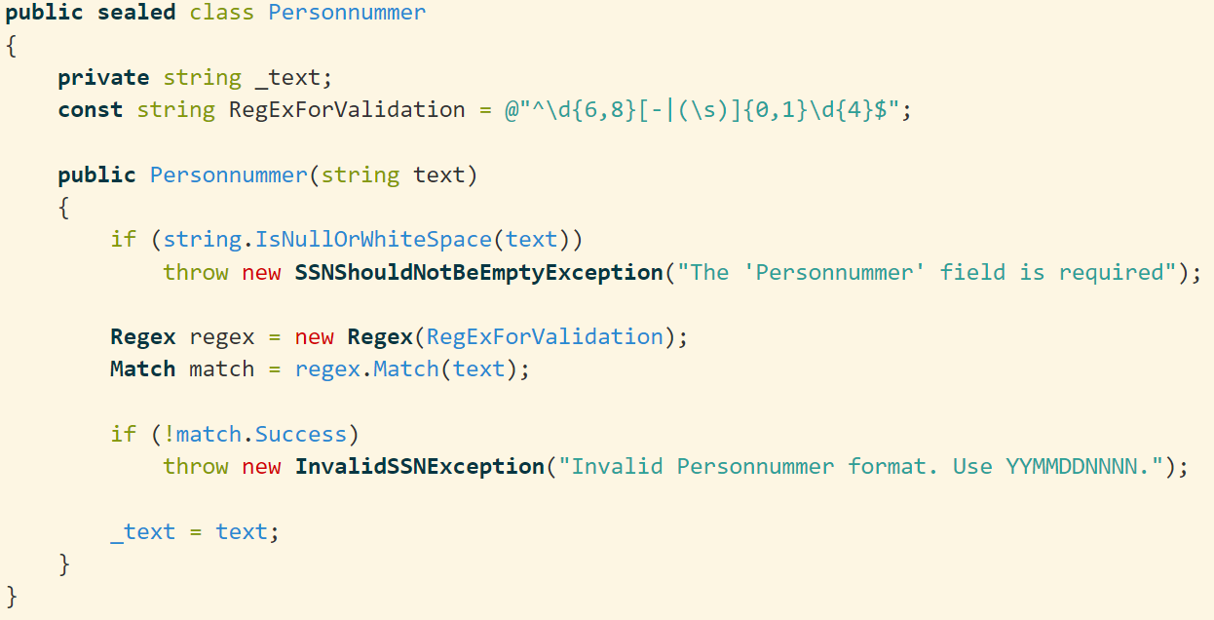
Personnummer Value Object
Notes:
it simple do not exist if invalid

Slide 34
First-Class Collections
Each collection should be wrapped in its own class¹.
Classes that contains collections do not contains any other variable.
Behaviors have a home.
When necessary return immutable collection copies.
Account
Transaction
1:N
¹The ThoughtWorks Anthology: Essays on Software Technology and Innovation (Pragmatic Programmers), 2008

Slide 35
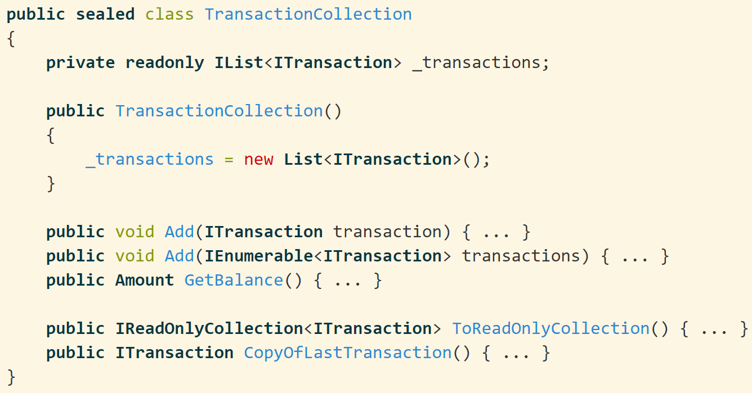
First-Class TransactionCollection
Notes:
it simple do not exist if invalid

Slide 36
First-Class TransactionCollection
Copy collections and mutable objects when passing them between objects.¹
¹Growing Object-Oriented Software Guided by Tests, 2010
Notes:
it simple do not exist if invalid

Slide 37
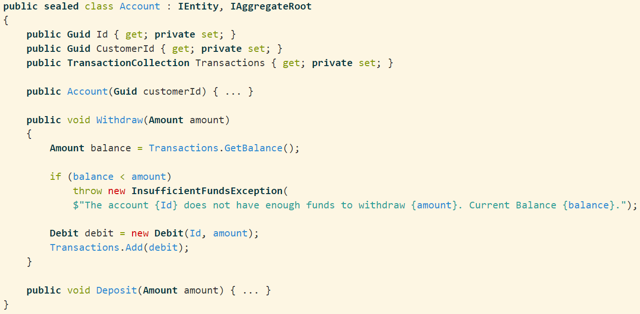
How to Use the TransactionCollection Class
Notes:
it simple do not exist if invalid

Slide 38
How to Use the TransactionCollection Class
The GetBalance() implementation belongs to the TransactionCollection class.
Notes:
it simple do not exist if invalid

Slide 39
How to Use the TransactionCollection Class
Composite simpler than the sum of its parts
The GetBalance() implementation belongs to the TransactionCollection class.
Notes:
it simple do not exist if invalid

Slide 40
Inner and outer feedback loops in TDD
Write a failing acceptance test
Write a failing unit test
Make the
test pass
Refactor

Slide 41
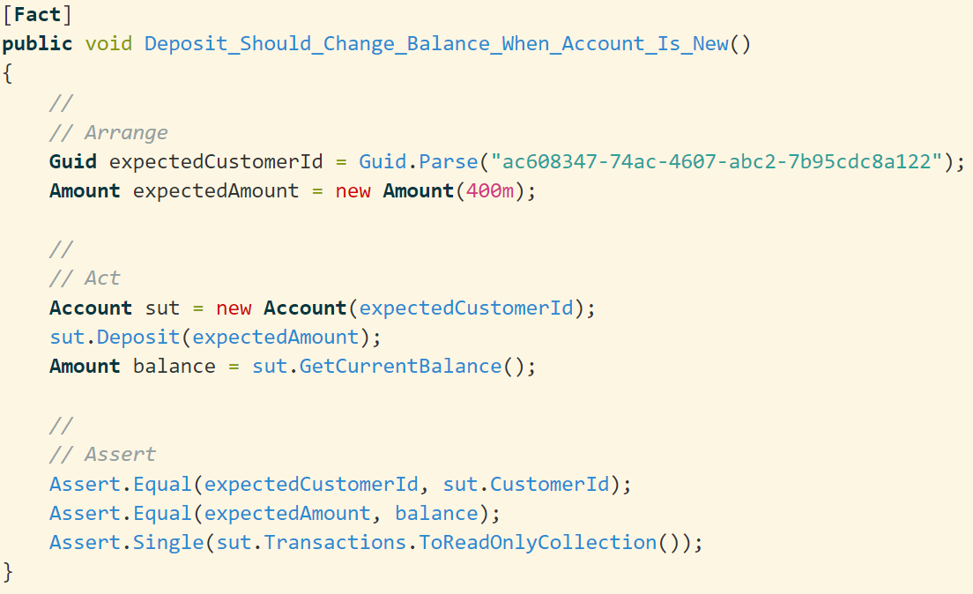
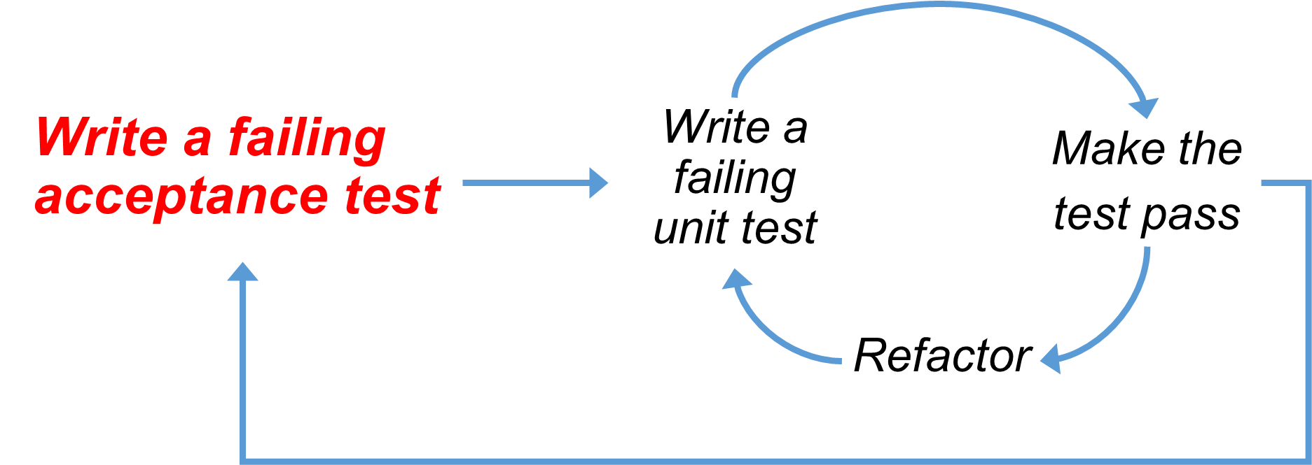
Notes:
it simple do not exist if invalid

Slide 42
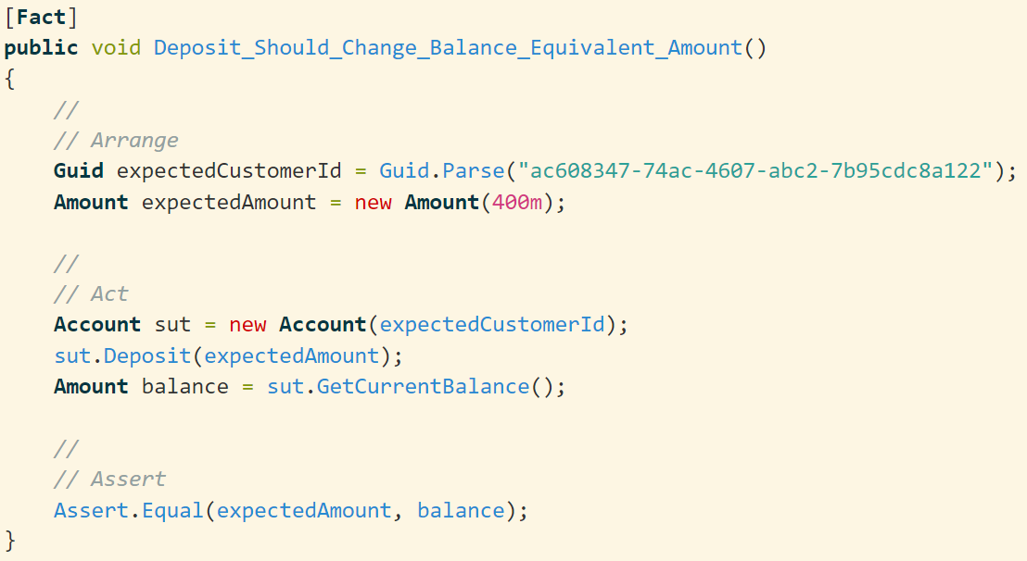
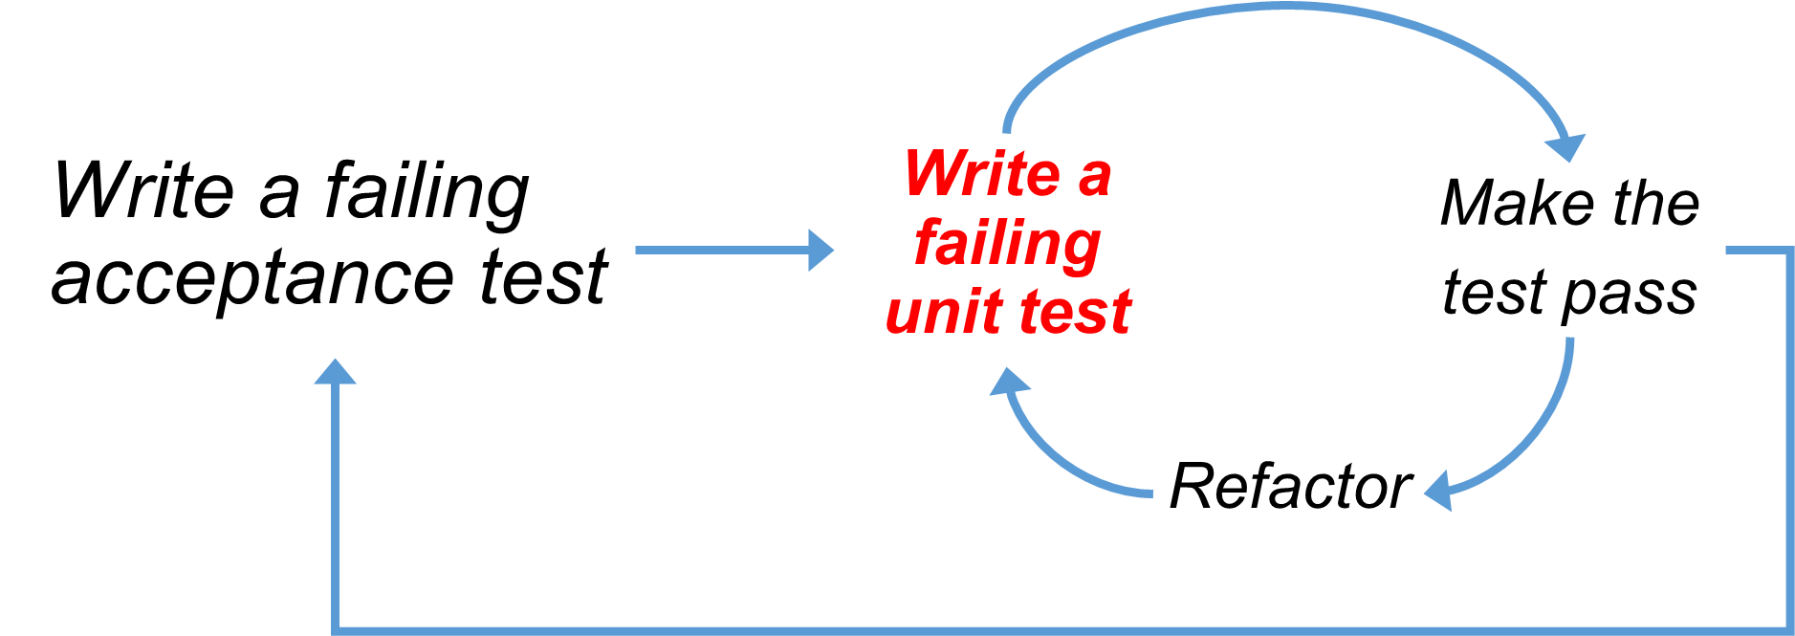
Notes:
it simple do not exist if invalid

Slide 43
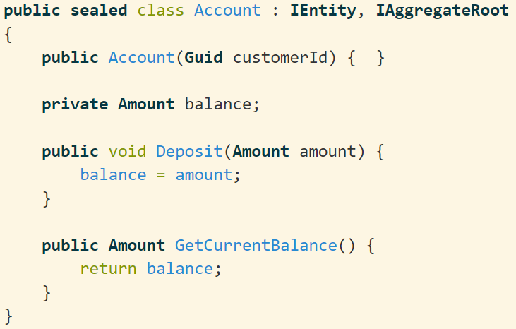
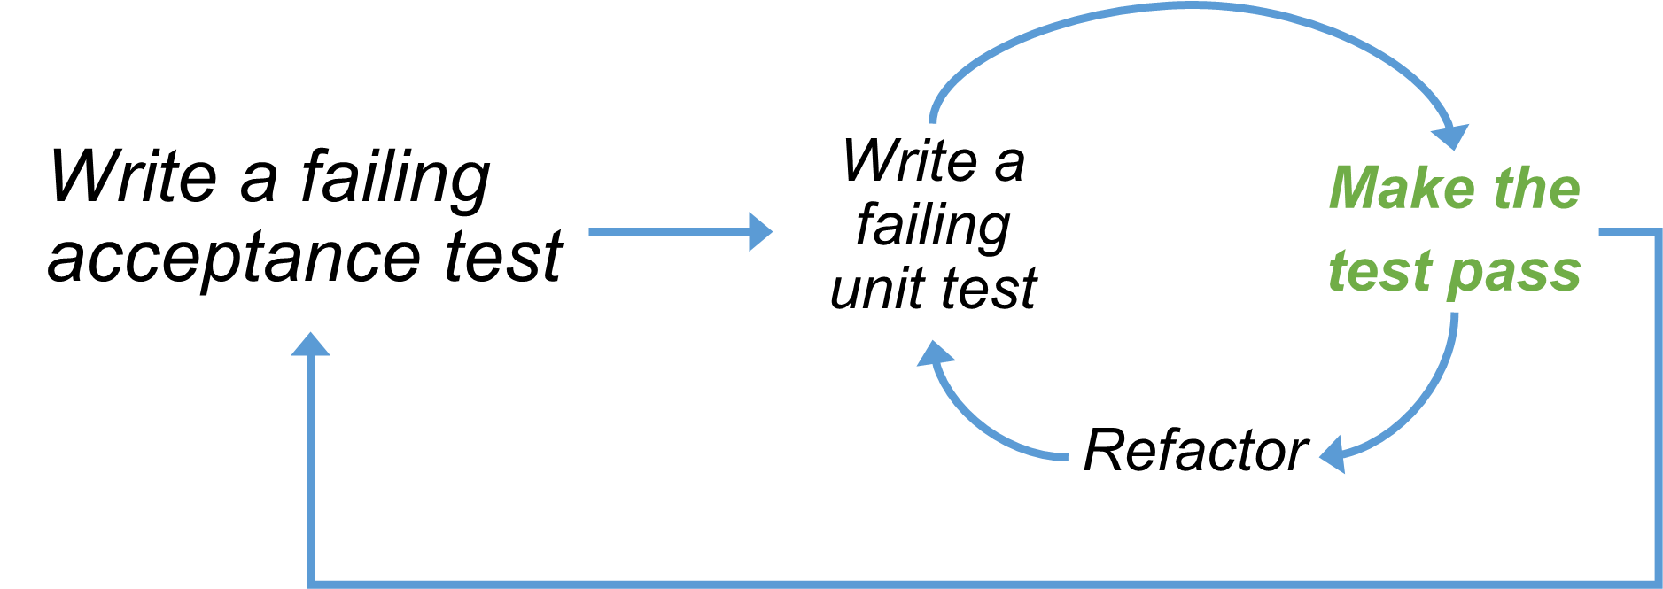
Notes:
it simple do not exist if invalid

Slide 44
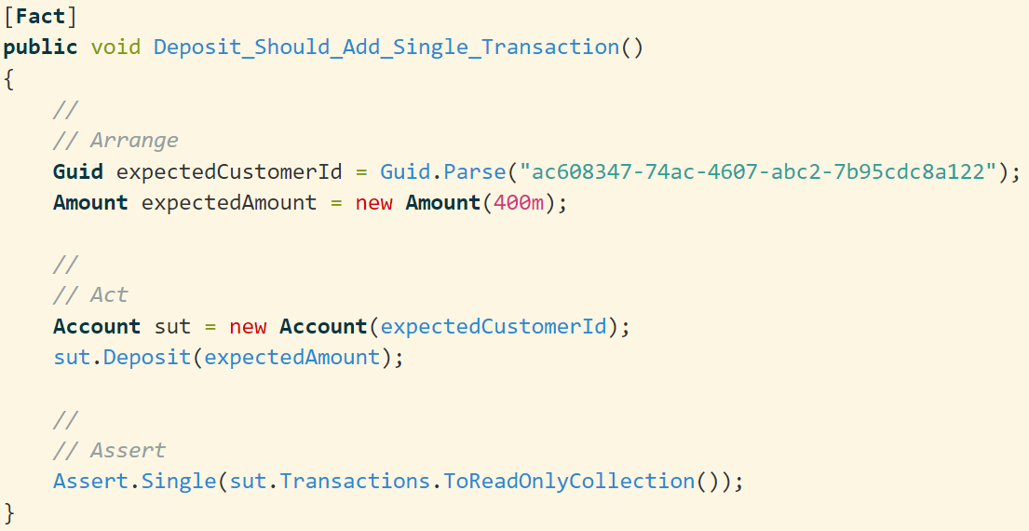
Notes:
it simple do not exist if invalid

Slide 45
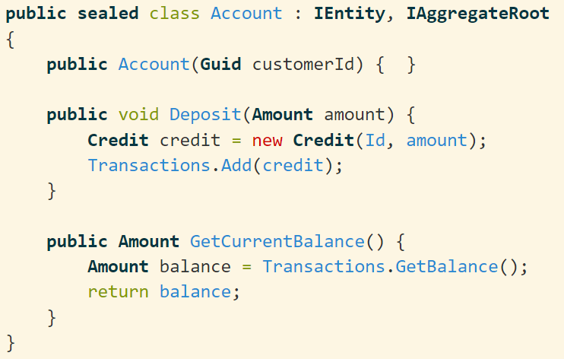
Notes:
it simple do not exist if invalid

Slide 46
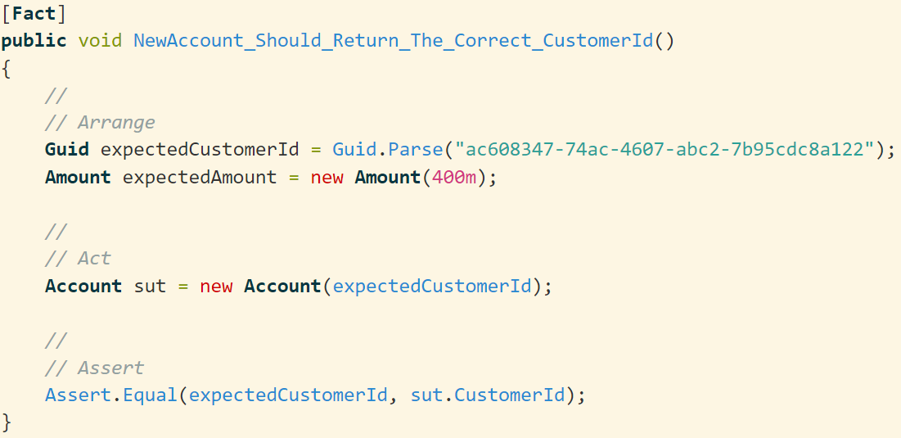
Notes:
it simple do not exist if invalid

Slide 47
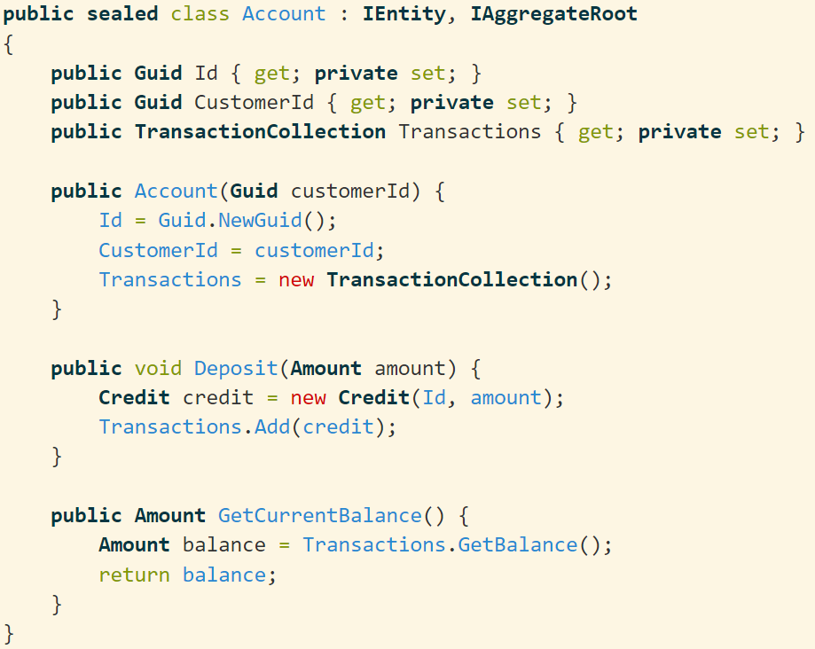
Notes:
it simple do not exist if invalid

Slide 48
Opinionated DDD/TDD
Sometimes I implement too much of the Domain Model. Then return covering it with unit tests.
By knowing the DDD patterns I underestimate the TDD value then I'm slapped in the face.
My goal is to maintain a high test coverage on the Domain Model.
If testing is hard. It is an architectural issue!

Slide 49
I won’t reverse engineer my data model to create a domain model.
Notes:
If you're calling two setters in a row, you're missing a concept.
Don't get trapped by datastore thinking.

Slide 50
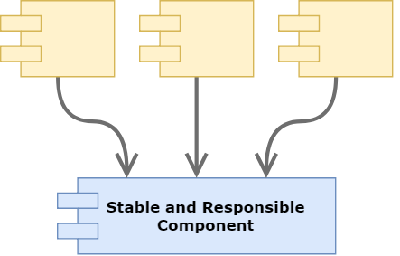
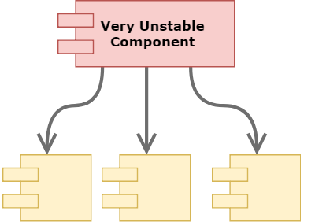
The Stable Dependencies Principle¹
¹Clean Architecture, Robert C. Martin, 2017

Slide 51
The Stable Dependencies Principle
Infrastructure
Web
Application
Domain

Slide 52

The Stable Dependencies Principle
Infrastructure
Web
Application
Domain
Shining Framework
Shining Library

Slide 53
The Stable Dependencies Principle
Infrastructure
Web
Application
Domain
Shining Framework
Shining Library

Slide 54
Isolate the Domain with a Layered Architecture
Web
Devices
Controllers
Use Cases
Entities
Gateways
DB
UI
Presenters
External Interfaces

Slide 55
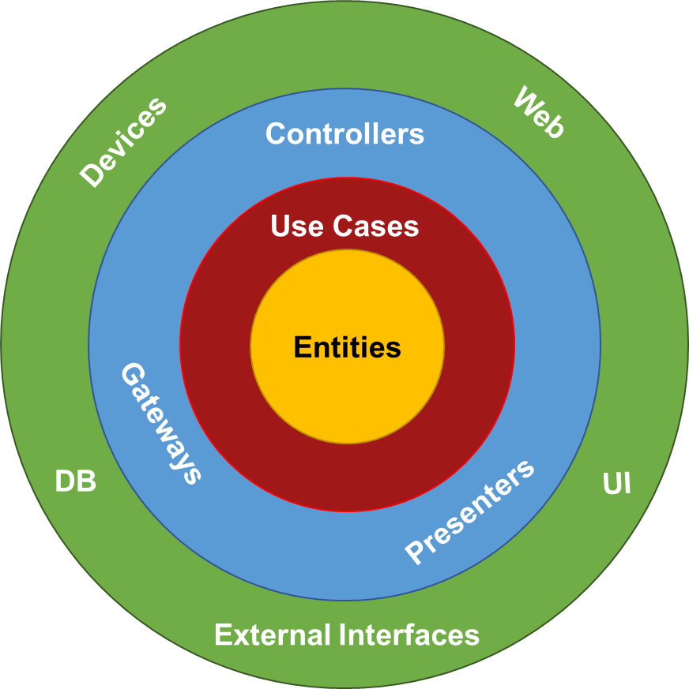
Testing Strategies
Outside In
Controllers > Use Cases > Aggregates > Value Objects
Inside Out
Aggregates > Value Objects
Use Cases
Controllers

Slide 56
Quick Review
DDD Patterns
Ubiquitous Language
Testing
Application Design
Implementation Samples

Slide 57
Quick Review
DDD Patterns
Ubiquitous Language
Testing
Application Design
Implementation Samples

Slide 58
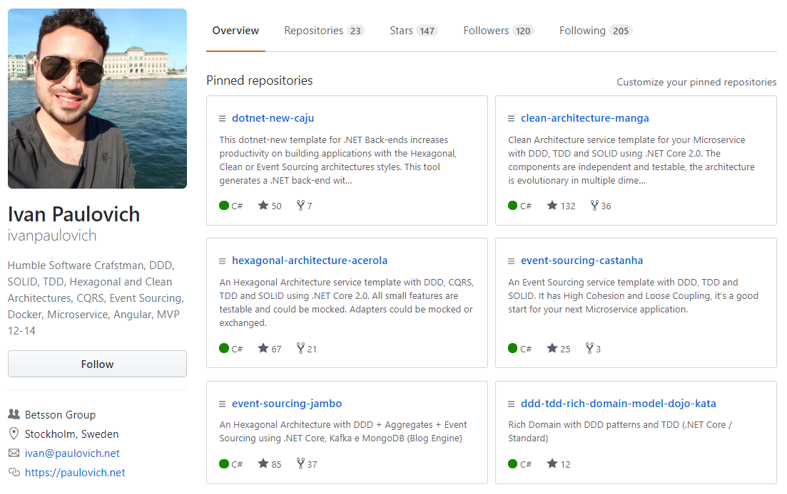
Implementation Samples
Fork me on GitHub
Clean Architecture
Hexagonal Architecture
Event Sourcing
DDD
TDD
Microservices

Slide 59
Resources
Domain-driven Design, Eric J. Evans, 2003
The ThoughtWorks Anthology: Essays on Software Technology and Innovation (Pragmatic Programmers), 2008
Clean Architecture, Robert C. Martin, 2017
Growing Object-Oriented Software, Guided by Tests, 1st Edition, 2009
Secure by Design, Dan Bergh Johnsson, Daniel Deogun, Daniel Sawano, 2018
Domain-Driven Design Quickly, 2007
Effective Aggregate Design, Vaughn Vernon, 2011

Slide 60
https://paulovich.net
ivan@paulovich.net
@ivanpaulovich

Slide 61
@ivanpaulovich

Slide 62
Inner and outer feedback loops in TDD
Write a failing acceptance test
Write a failing unit test
Make the
test pass
Refactor

Slide 63
Inner and outer feedback loops in TDD
Write a failing acceptance test
Write a failing unit test
Make the
test pass
Refactor

Slide 64
Inner and outer feedback loops in TDD
Write a failing acceptance test
Write a failing unit test
Make the
test pass
Refactor

Slide 65
Inner and outer feedback loops in TDD
Write a failing acceptance test
Write a failing unit test
Make the
test pass
Refactor

